Slide 1
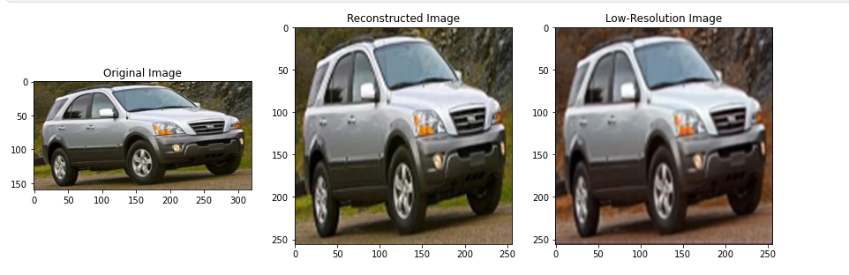

IMAGE PROCESSING PROJECT Presentation
IMAGE
SUPER-RESOLUTION
Uday Sankar Mukherjee(38)
Atrij Paul(43)
Sukrit Das(60)
With Prof. Subhadeep Chanda

Slide 2

In the ever-evolving landscape of image processing, the quest for enhancing the quality of digital images has been a longstanding endeavor. Image Super Resolution (ISR) stands at the forefront of this pursuit, aiming to reveal intricate details and nuances in low-resolution images.
Image Super Resolution refers to the task of enhancing the resolution of an image from low-resolution (LR) to high (HR). It is popularly used in the following applications: Surveillance: to detect, identify, and perform facial recognition on low-resolution images obtained from security cameras.
ABOUT
Within this realm, autoencoders emerge as a promising tool, harnessing the power of unsupervised learning to extract and reconstruct high-resolution representations from low-quality inputs.
Super resolution image reconstruction is to obtain a high-resolution image from a sequence of low-resolution images which are degraded by unknown blur, noise, and down sample.

Slide 3

AIM AND OBJECTIVES:
Investigating the efficacy of autoencoder architectures in enhancing the resolution of low-quality images and training the autoencoder model on a curated dataset of low and high-resolution image pairs to learn meaningful representations.
Uncover advanced techniques such as early stopping, model checkpointing, and learning rate reduction to optimize the training efficiency of the autoencoder.
Evaluate the performance of the trained autoencoder in reconstructing high-resolution images with remarkable clarity and detail.

Slide 4
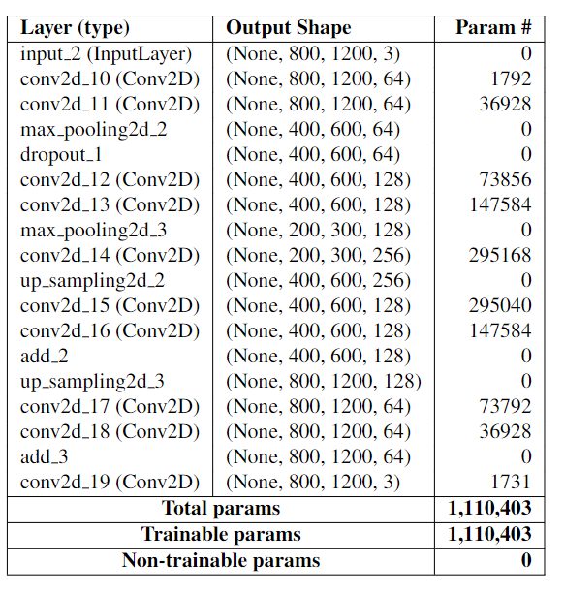

MODEL
Autoencoders, a class of neural networks, possess the unique ability to learn compact and meaningful representations of data by encoding and decoding input information. This project embarks on a journey into the transformative capabilities of autoencoders in enhancing the resolution of images of low quality.

Slide 5
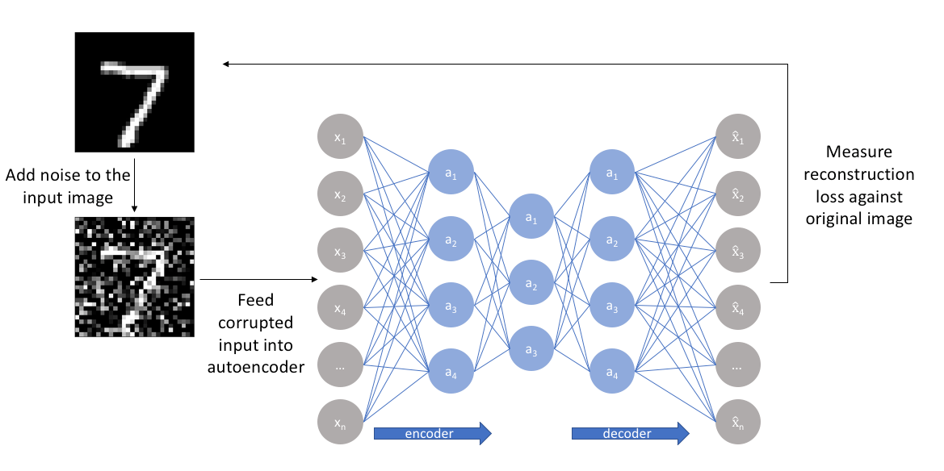
BASIC AUTOENCODER

Slide 6
The encoder component transforms the input 𝑋
into a latent representation 𝑍 using convolutional layers and
pooling:
𝑍 = Encoder(𝑋) (1)
𝑍 = ReLU(Conv2D(𝑋, 𝑊enc1, 𝑏enc1)) (2)
𝑍 = ReLU(Conv2D(𝑍, 𝑊enc2, 𝑏enc2)) (3)
𝑍 = MaxPooling2D(𝑍) (4)
The latent space representation 𝑍 is then
modified with dropout for regularization:
𝑍dropout = Dropout(𝑍) (5)
𝑋reconstructed = Decoder(𝑍dropout) (6)
𝑋reconstructed = Conv2DTranspose(𝑍dropout, 𝑊dec1, 𝑏dec1) (7)
𝑋reconstructed = Conv2DTranspose(𝑋reconstructed, 𝑊dec2, 𝑏dec2) (8)
𝑋reconstructed = UpSampling2D(𝑋reconstructed) (9)
The decoder reconstructs the input from the latent
representation:

Slide 7

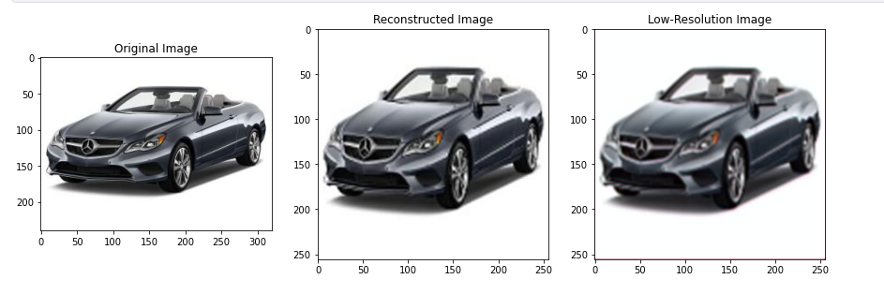
SOME RESULTS

Slide 8
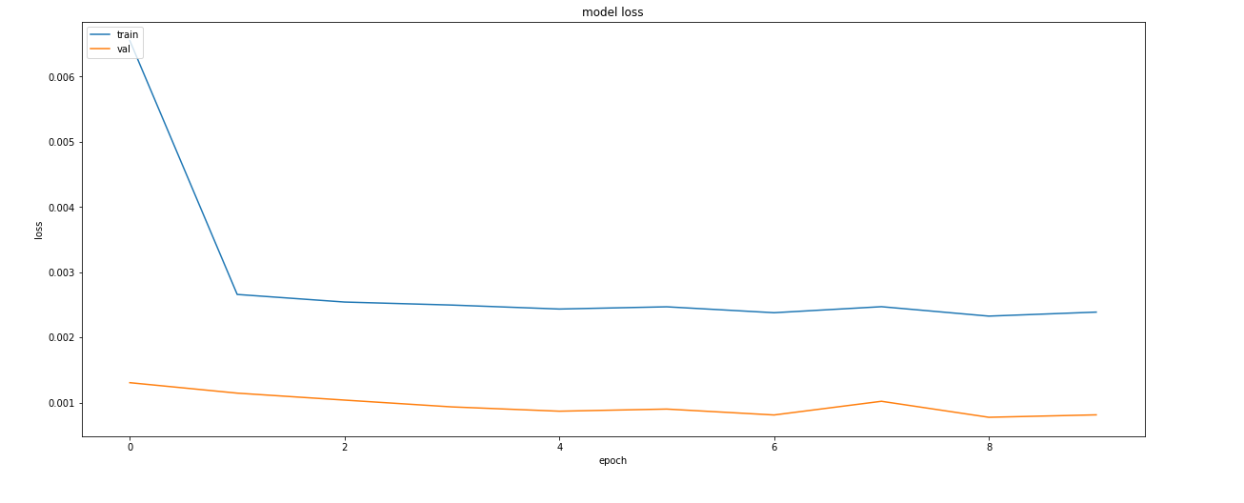

GRAPH
Training Loss Curve

Slide 9


KEY METRICES
Accuracy
No.of Epochs
90.41%
09
Validation
Accuracy
Total Time
Taken
89.03%
8365 s

Slide 10


THANK YOU!
@github

